Slide 1



Slide 2
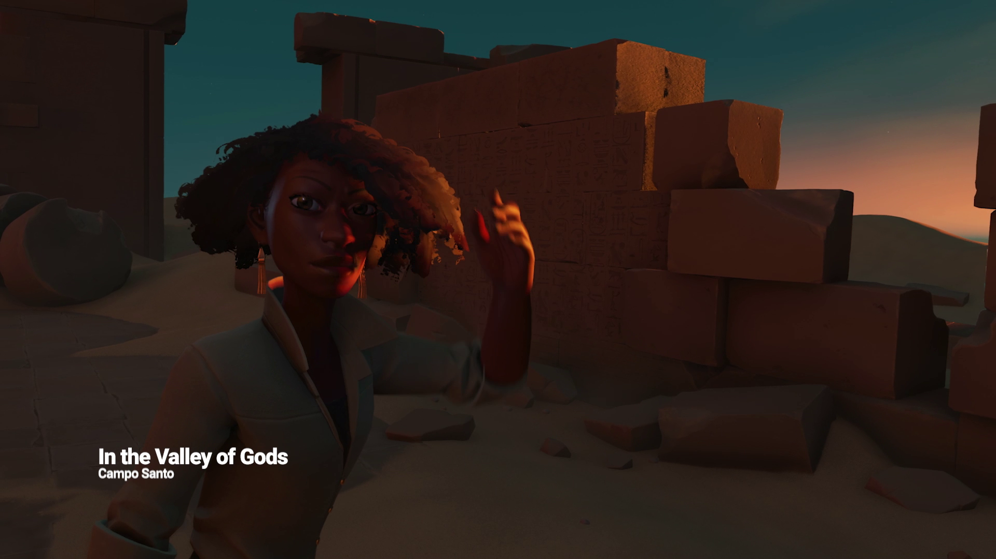

Slide 3
Unity tools to accelerate your MR Development

Slide 4
Arturo Nereu @ArturoNereu - arturo@unity3d.com

Slide 5
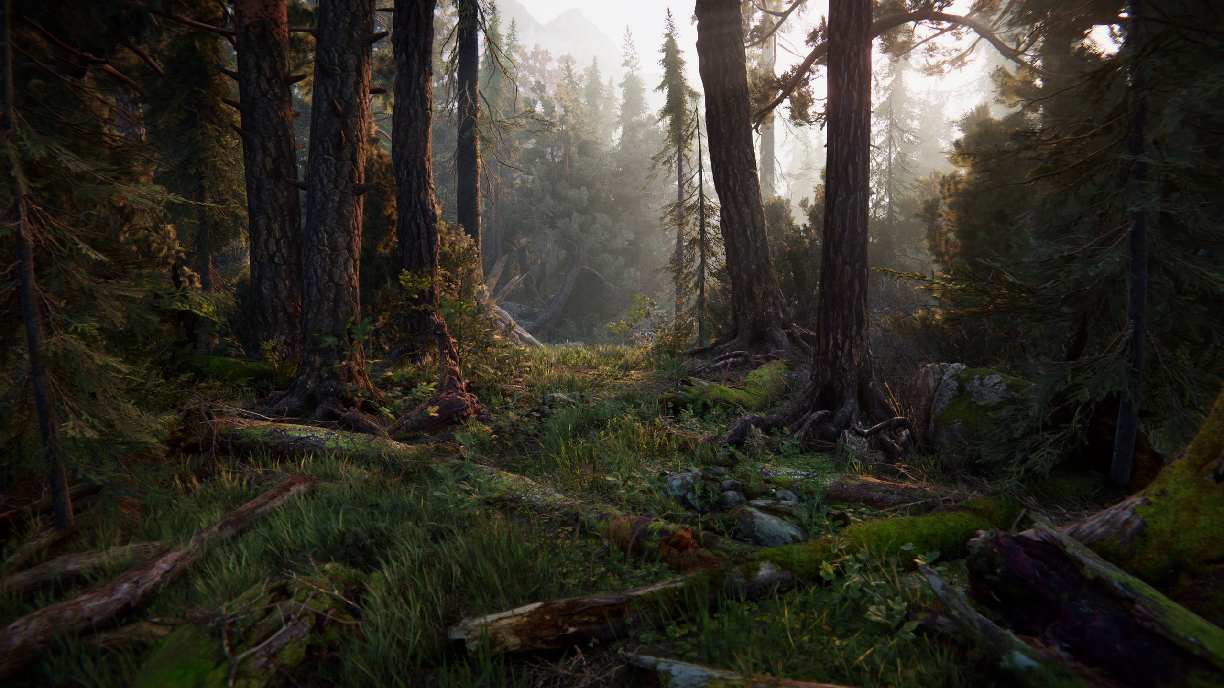

Slide 6
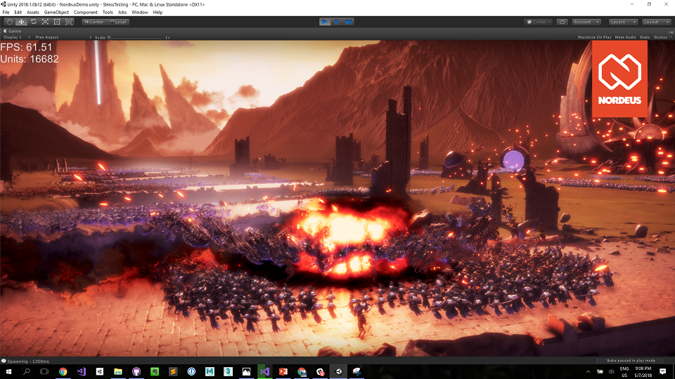

Slide 7
Get the project! github.com/ArturoNereu/UnityMRJam/

Slide 8
ProBuilder

Slide 9
TextMesh Pro

Slide 10
Timeline

Slide 11
Get the project! github.com/ArturoNereu/UnityMRJam/

Slide 12
Thank you! @ArturoNereu - arturo@unity3d.com

